Slide 1
RISC V
The RISC V Primer by P Suresh

Slide 2
Contents
1.Introduction to RISC V
2.RISC V Operation Modes
3.RISC V Registers and Extensions
4.Instruction Format of RISC V
5.RTL Architecture of RISC V
6.Custom Instruction

Slide 3
Introduction to RISC V and its features
RISC-V is an open standard instruction set architecture (ISA) based on the Reduced Instruction Set Computer (RISC) principles. It's a modular, extensible, and suitable for a wide range of applications, from embedded systems to high-performance computing.

Slide 4
RISC-V, as an open instruction set architecture (ISA), offers a range of features that make it usable for various applications. Here are some of its key features:
1. Open Standard: RISC-V is an open standard ISA, maintained by the RISC-V International organization. The ISA specifications are freely available, allowing anyone to implement RISC-V processors without needing to pay royalties or license fees.
2. Modularity: RISC-V ISA is designed to be modular, with various standard extensions available for additional functionality. These extensions include integer (I), multiply/divide (M), floating-point (F), double-precision floating-point (D), atomic (A), vector (V), and cryptographic (C) extensions, among others. This modular design allows for tailored implementations depending on the target application's requirements.

Slide 5
3. Simplicity: RISC-V emphasizes simplicity and orthogonality in its instruction set design. Instructions are generally simple and uniform, with a consistent format and encoding scheme. This simplicity makes RISC-V easy to understand, decode, and implement efficiently.
4. Variants: RISC-V defines several standard base integer instruction set variants, such as RV32I (32-bit), RV64I (64-bit), and RV128I (128-bit). These variants specify the width of the general-purpose registers, addressing modes, and other architectural features, providing flexibility for different use cases.
5. Privileged Architecture: In addition to user-level instructions, RISC-V also defines a privileged architecture for operating systems and system software. The privileged architecture includes modes like machine mode, supervisor mode, and user mode, along with corresponding instructions for handling interrupts, exceptions, and system calls.

Slide 6
6. Memory Model: RISC-V provides a relaxed memory consistency model, allowing for efficient implementations on various memory systems, including multi-core processors and distributed systems. It offers memory ordering constraints through memory ordering fences and synchronization primitives.
7. Scalability: RISC-V is designed to be scalable, supporting a wide range of devices and applications, from embedded systems to high-performance computing. Its modular design and customizable features make it suitable for use in diverse environments, including IoT devices, smartphones, data centers, and supercomputers.
8. Community and Ecosystem: RISC-V has a vibrant and growing ecosystem, with support from hardware vendors, software developers, and research communities worldwide. It benefits from collaborative development efforts, innovation, and contributions across different domains, fostering an open and collaborative environment for ISA design and implementation.

Slide 7
Operation Modes
In the RISC-V architecture, operation modes are known as privilege modes, and they define the level of privilege or access rights that a program or system software can have. There are three primary privilege modes defined in RISC-V:
1. Machine Mode (M Mode):
Machine mode is the highest privilege mode in RISC-V. In this mode, the processor has full access to all resources and can execute privileged instructions. Machine mode is typically used by system software, such as the operating system kernel, to manage the system's hardware resources and handle exceptions and interrupts. Exception handlers and interrupt service routines are executed in machine mode. Machine mode is entered on power-up or reset and can also be entered through a machine-level software interrupt (ecall instruction with a specific function code).

Slide 8
2. Supervisor Mode (S Mode):
Supervisor mode is a less privileged mode compared to machine mode but more privileged than user mode. In this mode, the processor can execute privileged instructions and access certain system resources. Supervisor mode is typically used by the operating system kernel to perform tasks that require higher privilege, such as process management, memory management, and I/O operations. User-level applications run in user mode and switch to supervisor mode when making system calls or when encountering exceptions that require intervention from the operating system. Supervisor mode can be entered through an exception or trap, such as a system call (ecall instruction), timer interrupt, or external interrupt.

Slide 9
3. User Mode (U Mode):
User mode is the least privileged mode in RISC-V. In this mode, the processor can execute only a subset of instructions and cannot directly access privileged resources. User mode is used by application programs to run user-level code, such as user applications and user-space libraries. User mode applications rely on system calls to request services from the operating system, such as I/O operations, file system access, and process management. User mode is entered by default when a program starts execution and can be entered from supervisor mode when returning from a system call or exception handler.

Slide 10
4. Hypervisor Mode (H Mode):
Hypervisor mode is a privilege mode introduced in the RISC-V Privileged Architecture Specification version 1.11. It is designed to support virtualization, allowing multiple operating systems (guests) to run concurrently on a single hardware platform. Hypervisor mode sits between machine mode and supervisor mode in terms of privilege level, enabling it to manage and control virtualized resources. In hypervisor mode, the hypervisor software runs alongside the system software (e.g., the operating system kernel) and manages virtual machines (VMs) and their resources. Hypervisor mode introduces additional instructions and features to support virtualization, such as virtual memory management, virtual interrupts, and VM management instructions.

Slide 11
5. Debug Mode (D Mode):
Debug mode is a special-purpose mode used for debugging and system-level diagnostics. It provides facilities for software debugging, such as breakpoints, watchpoints, single-stepping, and register inspection/modification. Debug mode typically operates at a higher privilege level than machine mode, allowing it to control and monitor the execution of software running in machine mode. It enables external debugging tools, such as debuggers and emulators, to interact with the processor and inspect the state of the system. Debug mode may have different implementations and features depending on the specific hardware platform and debugging environment.

Slide 12
RISC V Register File
The register file in the RISC-V architecture is a collection of general-purpose registers (GPRs) that store data temporarily during program execution. Here's an overview of the register file in RISC-V:
1. General-Purpose Registers (GPRs):
RISC-V defines a set of general-purpose registers that are used for general data processing operations.
The number of GPRs and their widths may vary depending on the specific variant of the RISC-V ISA.
Common variants include RV32I (32-bit), RV64I (64-bit), and RV128I (128-bit), which have 32, 64, and 128 general-purpose registers, respectively.
The registers are typically denoted as `x0` through `x31` in assembly language, where `x0` is hardwired to the value 0 and is used as the constant zero register.

Slide 13
2. Special-Purpose Registers (SPRs):
In addition to general-purpose registers, RISC-V also defines several special-purpose registers that serve specific purposes, such as program counters, stack pointers, and status/control registers.
Special-purpose registers include the program counter (`pc`), stack pointer (`sp`), frame pointer (`fp`), and various control and status registers used for handling exceptions, interrupts, and system-level operations.

Slide 14
3. Register Width:
The width of general-purpose registers in RISC-V varies depending on the ISA variant.
For example, in RV32I, the width of each register is 32 bits, while in RV64I, it is 64 bits, and in RV128I, it is 128 bits.
The wider register widths in RV64I and RV128I provide increased precision and addressability for applications that require larger data sizes and address spaces.

Slide 15
4. Register Operations:
RISC-V instructions operate on data stored in the register file.
Instructions can read data from registers, perform arithmetic or logical operations, and write the results back to registers.
The register file is accessed during each instruction execution cycle to fetch operands, perform computations, and store results.

Slide 16
5. Data Storage:
The register file is typically implemented using fast, on-chip storage elements, such as flip-flops or static random-access memory (SRAM).
Registers are directly accessible by the processor's execution units, enabling fast data manipulation and computation.
Overall, the register file in RISC-V provides a set of temporary storage locations for holding data during program execution. It plays a critical role in facilitating efficient data processing and manipulation within RISC-V processors.

Slide 17
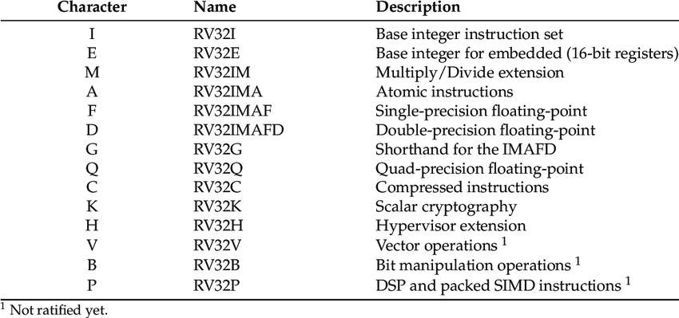
RISC V Extensions
In RISC-V, extensions refer to optional sets of instructions that provide additional functionality beyond the base integer instruction set. These extensions are modular and can be added to a RISC-V processor base instruction set to tailor it for specific applications or use cases. Here are some of the key extensions defined in the RISC-V ISA.

Slide 18
Instruction Format of RISC V
The instruction format in the RISC-V architecture is designed to be simple, efficient, and easy to decode. RISC-V instructions are encoded using fixed-length instruction formats, with different formats for different types of instructions. Here's an overview of the basic instruction formats in RISC-V:
1. R-Type Format:
Used for arithmetic and logical instructions that operate on two source registers and store the result in a destination register.
Format: `{opcode} {rd} {funct3} {rs1} {rs2} {funct7}`
Example: `add rd, rs1, rs2`

Slide 19
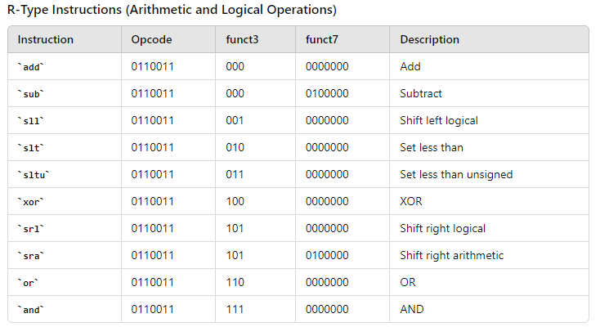
R Type format

Slide 20
2. I-Type Format:
Used for immediate instructions where an immediate value is added to a register value, and the result is stored in a destination register.
Format: `{opcode} {rd} {funct3} {rs1} {imm}`
Example: `addi rd, rs1, imm`

Slide 21
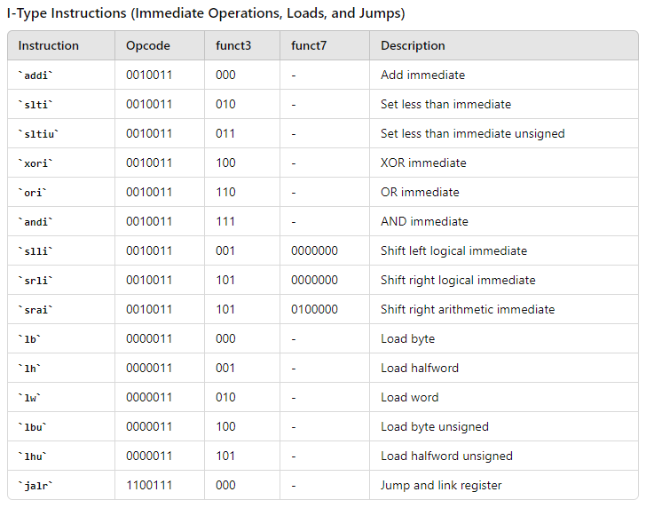
I Type format

Slide 22
3. S-Type Format:
Used for store instructions where a value from a source register is stored into memory at an address computed from a base register and an immediate offset.
Format: `{opcode} {imm[11:5]} {funct3} {rs1} {rs2} {imm[4:0]}`
Example: `sw rs2, offset(rs1)`

Slide 23
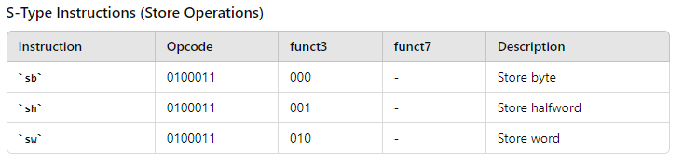
S Type format

Slide 24
4. B-Type Format:
Used for branch instructions where a branch is taken if a certain condition is met.
Format: `{opcode} {imm[12]} {imm[10:5]} {funct3} {rs1} {rs2} {imm[4:1]} {imm[11]}`
Example: `beq rs1, rs2, offset`

Slide 25
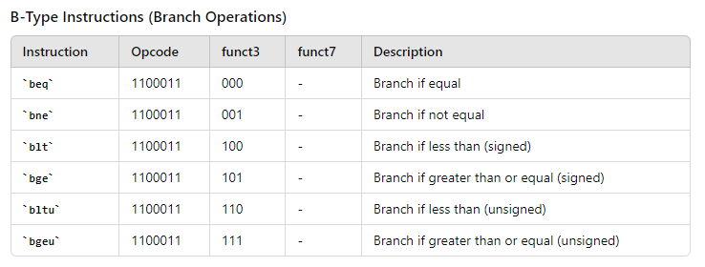
B Type format

Slide 26
5. U-Type Format:
Used for upper immediate instructions that load a 20-bit immediate value into the upper bits of a destination register, with the lower bits set to zero.
Format: `{opcode} {rd} {imm}`
Example: `lui rd, imm`

Slide 27
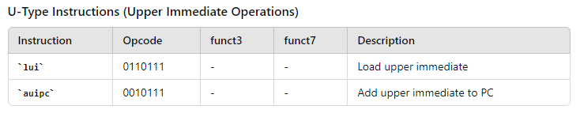
U Type format

Slide 28
6. J-Type Format:
Used for jump instructions that compute a target address by adding an immediate value to the program counter (PC).
Format: `{opcode} {rd} {imm}`
Example: `jal rd, offset`
In addition to these basic instruction formats, RISC-V also supports custom instruction formats through its encoding space. These custom instructions allow for domain-specific optimizations and extensions tailored to specific applications. Overall, the fixed-length instruction formats in RISC-V make instruction decoding simple and efficient, contributing to the architecture's ease of implementation and performance.

Slide 29
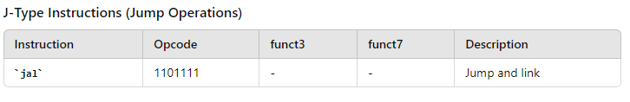
J Type format

Slide 30
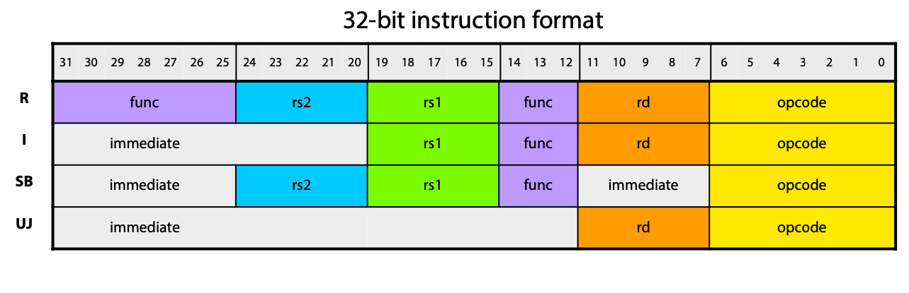
RISC V Core Instruction Format

Slide 31
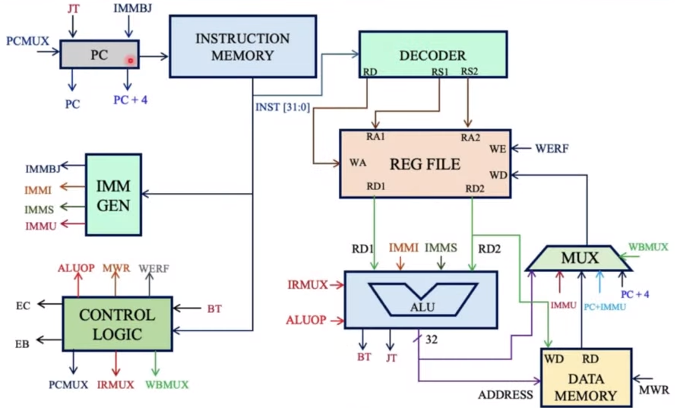
RISC V RTL Architecture of RV32I
RTL stands for Register Transfer Level, and it refers to a level of abstraction in digital design where hardware circuits are described in terms of registers, logic gates, and data paths. RTL architecture describes the internal structure of a digital system at this level of the abstraction, typically it is represented using a Hardware Description Language (HDL) such as Verilog or VHDL.

Slide 32
Why Customize….?
1. Improved Performance :
Faster Execution: The processor can execute the custom operation more quickly than a generic implementation, especially for frequently used computations.
Reduced Instruction Count: Using a specialized instruction can reduce the number of instructions needed to perform this computation, leading to more compact and efficient code.
Lower Latency and Single Cycle Execution: If the GCD operation is implemented in hardware, it can be executed in a single processor cycle, compared to multiple cycles or more complex routines in software.

Slide 33
Why Customize….?
2. Energy Efficiency : For Mobile and Embedded Systems (battery-powered devices or embedded systems), efficient computation can translate to longer battery life and more efficient operation.
3. Application-Specific Benefits: Some algorithms and protocols which rely on custom calculations. For example, RSA cryptography and other public-key algorithms use customized operations to be more secure. Accelerating these operations can improve the performance of such algorithms.

Slide 34
Adding Custom Instruction
Procedure to add a custom instruction for a RISC V based processor :
1. Write Custom instruction in the instruction decoder file(.v or .sv file) for the specific task. The added instruction should be unique as it should not conflict with the existing instructions.
2. Modify the RTL if the new instruction needs a change in the encoder, decoder, control logic, ALU, Register file or the memory management.
3. Refactor the Toolchain to update the assembler, compiler and linker.
Note:- We are emulating using Qemu hence we skip the 2nd step as the emulator translates the instruction format using a translation file (a .c file or a higher level language file). There will be no RTL level implementation in the emulator

Slide 35
Adding GCC Toolchain
First we need to install GCC tool chain in our pc. To install follow the below steps:-
1. Clone the prerequisites and GCC toolchain from git :
$ sudo apt-get install autoconf automake autotools-dev curl python3 python3-pip libmpc-dev libmpfr-dev libgmp-dev gawk build-essential bison flex texinfo gperf libtool patchutils bc zlib1g-dev libexpat-dev ninja-build git cmake libglib2.0-dev libslirp-dev
$ mkdir ~/riscv
$ cd ~/riscv $ git clone https://github.com/riscv/riscv-gnu-toolchain
2. Now navigate to the designated location and configure the build :
$ cd ~/riscv/riscv-gnu-toolchain
$ ./configure --prefix=/opt/riscv --with-arch=rv64gc --with-abi=lp64d
$ make

Slide 36
Adding Custom Instruction to GCC Toolchain
1. To add new instructions to the toolchain the first step is to modify the opcodes.
Path to the opcodes file : riscv-gnu-toolchain/riscv-binutils/opcodes/riscv-opc.c
This file contains all opcode (operation codes) or instruction definitions in an array riscv_opcodes.
Let us add the new instruction “gcd”, so the instruction is :
{"gcd"0,INSN_CLASS_I,"d,s,t",MATCH_GCD,MASK_GCD,match_opcode,0}

Slide 37
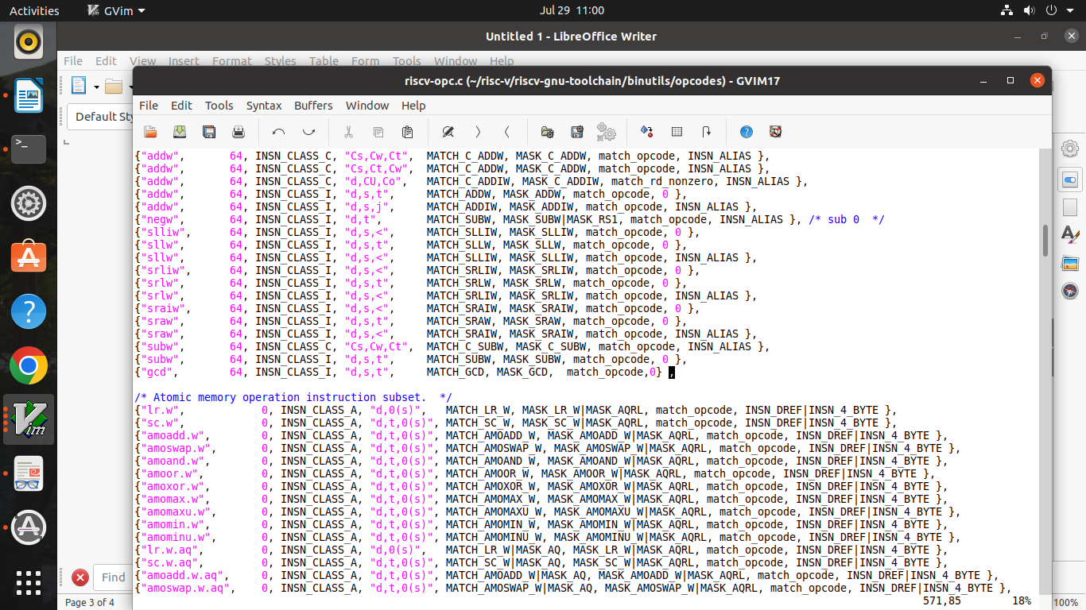
Adding Custom Instruction to GCC Toolchain

Slide 38
Adding Custom Instruction to GCC Toolchain
2. Now define the header for the added gcd instruction in the risc v-ocp.h header file :
Path for the header file : riscv-gnu-toolchain/binutils/include/opcode/riscv-opc.h
Add the match code and mask code for the instruction :
#define MACH_GCD 0x6027
#define MASK_GCD 0xfe00707f
DECLARE_INSN(gcd, MATCH_GCD,MASK_GCD)

Slide 39
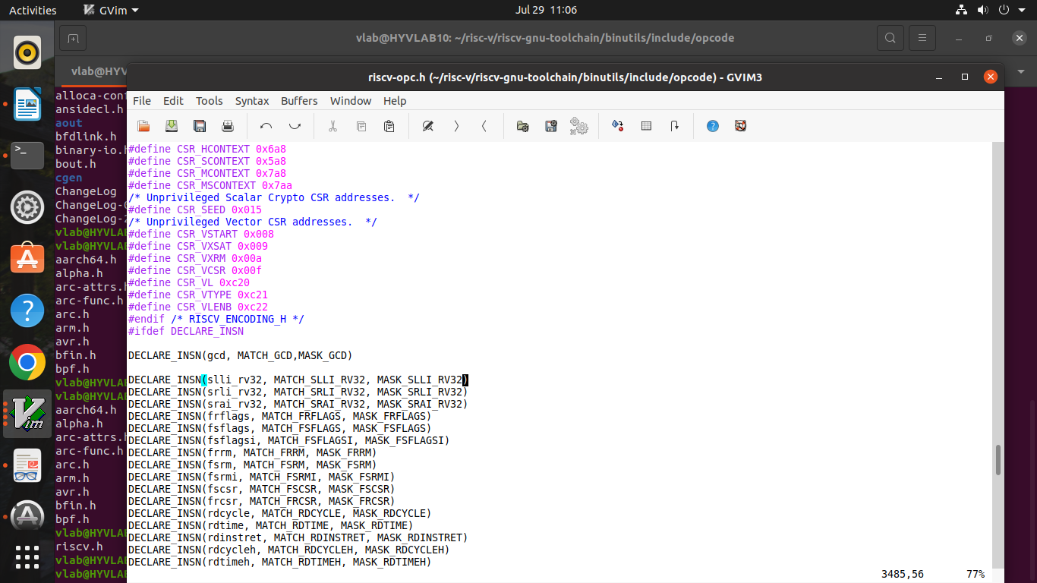
Adding Custom Instruction to GCC Toolchain

Slide 40
Translation Code for the Custom Instruction
Modify QEMU Source Code: Implement emulation support for your custom instructions in QEMU RISC-V target emulator.
Locate and modify the instruction decoder i.e translate.c in the QEMU source code.
Assign opcode and function value to your custom instruction :
# Custom instruction
gcd 0000001.............0000001011 @custom0
Translation code for the custom instruction :
static handle_gcd(uint32_t a, uint32_t b)
{
while (b != 0)
{
uint32_t t = b;
b = a % b;
a = t;
}
return a;
}

Slide 41
THANK YOU

